Slide 1
Advance Healthcare Directives: An Overview
Prof Mary Donnelly | Law School | University College Cork

Slide 2
Background
A legally enforceable decision about healthcare made in advance which will remain enforceable in the event of loss of capacity
Origins in Jehovah’s Witness communities
Grounded in right to refuse treatment
Set out in statute in most countries
Typically used in end-of-life care
Increasingly popular in mental health

Slide 3
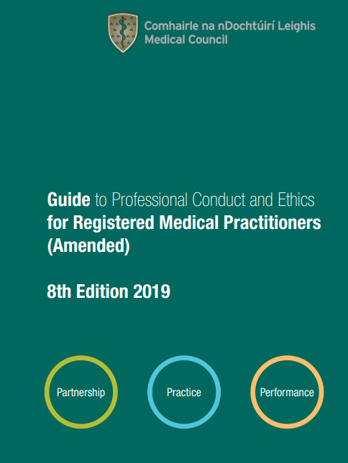
AHDs in (Pre-ADMCA) Law and Medical Ethics
Contemporaneous and advance right to refuse treatment affirmed by Irish Courts (although no detailed judicial treatment of advance refusal)
AHDs recognised by Medical Council Guide to Professional Conduct and Ethics (8th Ed), para. 16
You should do your best to help and support patients who ask assistance in writing an advance healthcare plan
You should ask patients with life limiting conditions if they have made an advance healthcare plan
An advance healthcare plan/directive has the same status as contemporaneous decision provided: informed choice; covers situations; nothing indicates patient has change mind
No obligation to provide treatment not clinically indicated
If questions arise re status of AHD, act in patient’s best interests

Slide 4
AHDs in the Assisted Decision-Making (Capacity) Act 2015 as amended
What is an AHD?
An advance expression made by the person of his or her will and preferences concerning treatment decisions that may arise in respect of him or her if he or she subsequently lacks capacity
What is treatment?
An intervention which has
a therapeutic purpose
a preventative purpose
a diagnostic purpose
a palliative purpose
Note: only legal mechanism to make advance treatment decisions – cannot make an Enduring Power of Attorney on treatment
Refusal or request
Appointment of Designated Healthcare Representative

Slide 5
Requirements for an AHD
Directive-maker must:
Be aged more than 18 years
Have decision-making capacity
No statutory requirement for formal assessment
Can be supported by Decision-Making Assistant (but not Co-Decision-Maker)
AHD must be in writing
Must be signed by Directive-maker and Designated Healthcare Representative (if one)
Must include Name, Date of Birth and Contact details of Directive-maker and DHR
Must be witnessed 2 witnesses
One witness must not be an immediate family member
Must contain express statement re life-saving/sustaining treatment if to apply

Slide 6
Requests for Treatment
Not legally binding
But
Must be taken into consideration in deciding most appropriate treatment (if relevant to the condition)
Reasons for not complying must be provided to DHR (within 7 days)

Slide 7
Refusal of Treatment
Legally binding if valid and applicable
This requires that :
AHD is voluntarily made
Directive-maker has not have done anything inconsistent while s/he has capacity
Directive-maker lacks capacity at the time the treatment decision is to be made
Treatment must be materially the same as AHD
Circumstances must be materially the same as AHD
If life-sustaining treatment, AHD must be specifically stated to apply

Slide 8
Exceptions to Right to Refuse Treatment
Basic Care
Treatment for a Mental Disorder under MHA
AHD refusing treatment for a mental disorder does not apply where directive-maker has been admitted under s. 3(1)(a) of Mental Health Act 2001 (risk to self and/or others)
AHD refusing treatment for a physical condition continues to apply
AHD may not refuse ‘basic care’
Includes (but is not limited to) warmth, shelter, food and liquids provided orally, and hygiene measures
Does not include artificial nutrition and hydration

Slide 9
Designated Healthcare Representative
Power to ensure conditions of AHD complied with
Can be empowered to:
Advise/interpret D-M’s will and preferences in accordance with AHD
Consent to/refuse treatment: can include life-sustaining treatment if expressly empowered

Slide 10
Resolving Ambiguity
Healthcare professional must:
Consult with DHR, if there is one
If no DHR
Consult with DM’s ‘family and friends’
Seek the opinion of a second healthcare professional
If still unresolved, must resolve in favour of preservation
of Directive-Maker’s life

Slide 11
Statutory Protection from Liability
No liability where:
HCP complies with a refusal of treatment in AHD and had reasonable ground to believe – and did believe - that AHD was valid and applicable
HCP does not comply with a refusal of treatment in AHD and has reasonable ground to believe – and did believe - that AHD was not valid and applicable
No liability where HCP did not act in compliance with refusal of treatment in AHD where:
s/he at that time had no grounds to believe an AHD existed
s/he had grounds to believe that an AHD existed but had:
No immediate access to the AHD and its contents and
The urgency of the medical condition was such that HCP could not reasonably delay taking appropriate action until s/he did have access

